Slide 1

Welcome

Slide 2
Business Analytics
Class - 02

Slide 3
Quick Recap
Python Basics
Pandas EDA Starting

Slide 4
What we will do today
Standardization
Normalization
Correlation
Scatter Plots
Box Plots
Missing Values

Slide 5

That’s it

Slide 6

Let’s go !!

Slide 7
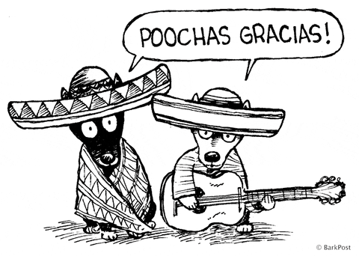
Thanks

